Slide 1
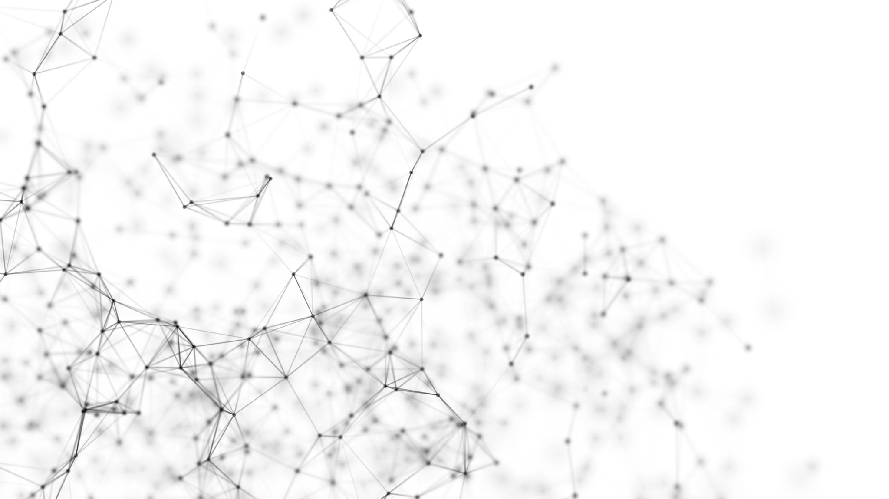
IMAGE CLASSIFICATION WITH CNN
Jarian Del Valle
Harid Lopez

Slide 2
PROJECT OVERVIEW
The goal of the project was to build a Convolutional Neural Network (CNN) model to classify images from a given dataset into predefined categories/classes.
The dataset chosen for this project is the CIFAR-10 dataset, which contains 60,000 32x32 color images in 10 classes, with 6,000 images per class.
Key learning objectives for this project are: data preprocessing, model architecture design, model training methods, model evaluation metrics, transfer learning and model deployment

Slide 3
IMPLEMENTATION DETAILS
1. Data Preprocessing
Techniques Applied:
Normalization: Rescale pixel values to the [0, 1] range.
Resizing: Ensure all images are resized to the required input dimensions for the CNN (e.g., 32x32).
Augmentation: Apply random transformations like rotation, flipping, and cropping to increase dataset diversity.
Visualization: Display sample images with corresponding labels for data validation.
2. CNN Architecture
Layer Composition:
Convolutional Layers: Apply filters to extract features.
Pooling Layers: Max-pooling to reduce spatial dimensions and control overfitting.
Fully Connected Layers: Dense layers to classify features into predefined categories.
Activation Functions: Use ReLU for hidden layers and softmax for the output layer to predict probabilities.

Slide 4
IMPLEMENTATION DETAILS
3. Model Training
Optimization: Use Adam or SGD optimizer to minimize the loss function.
Regularization: Apply dropout and early stopping to mitigate overfitting.
Hyperparameters:
Learning Rate: 0.00001
Bath Size: 64
Regularization: L2 regularization (with a factor of 0.0005) and dropout rate of 0.4
Epochs: Train for for up to 75 epochs, used with early stopping to prevent overfitting.
4. Model Evaluation
Metrics: Compute and report:
Accuracy: Proportion of correct predictions.
Precision, Recall, F1-score: Assess model's performance per class.
Confusion Matrix: Visualize true vs predicted labels for class-specific performance.

Slide 5
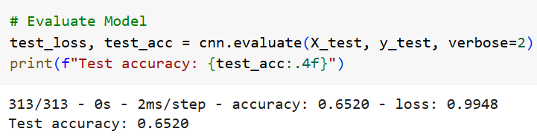
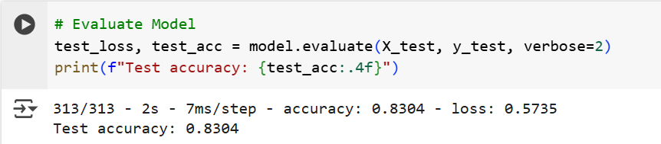
Model Evaluation- Test Accuracy
Baseline CNN Model Test Accuracy
Fine Tuned VGG16 Model Test Accuracy

Slide 6
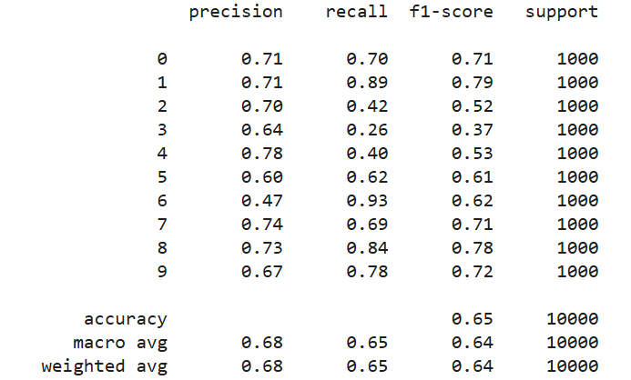
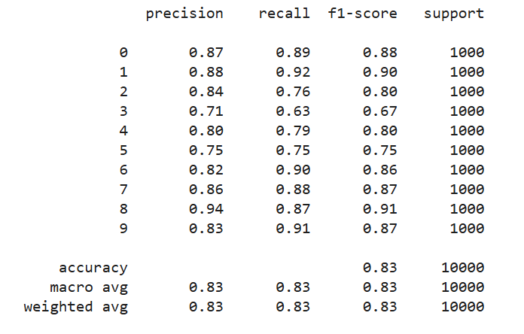
Model Evaluation
Confusion Matrix: Baseline CNN Model
Confusion Matrix: Fine Tuned VGG16 Model

Slide 7
CHALLENGES AND SOLUTIONS
Challenges
Initial baseline CNN underperformed, indicating the need for a more refined model
Initial VGG16 feature extraction model still needed to improve performance, indicating that fine tuning need to be done
Solutions
Ensure images were normalized to help improve model performance
Used the pre-trained VGG16 model for transfer learning to improve model accuracy
Fine tune VGG16 model to improve model accuracy to over 80%

Slide 8
TOOLS AND TECHNOLOGIES
TensorFlow/Keras: For building and training CNN models, utilizing built-in functions for layers, optimizers, and loss functions.
NumPy: Efficient handling of numerical data, especially for matrix operations during preprocessing and training.
Matplotlib: Used to create visualizations of model performance, such as loss curves, accuracy, and confusion matrices.
Seaborn: used in collaboration with pyplot for visualizations
Sci-kit learn: used to measure metrics such as confusion matrix

Slide 9
TEAMWORK AND PROJECT MANAGEMENT
Harid
Model architecture
Model training
Model Metrics
Transfer Learning
Presentation
Generating report
Jarian
Preprocess data
Model metrics
Model training
Transfer Learning
Presentation
Generating report

Slide 10
MAJOR OBSTACLE
A major obstacle encountered in the project was picking and experimenting with
hyperparameters for the transfer learning model, as this process was time consuming
A significant amount of time was needed in order to test the model multiple times every time there was an adjustment in a hyperparameter
Trying to get the model’s accuracy to be more than 80% on average was also a major obstacle, since it required precise fine tuning in order to get it above that threshold

Slide 11
INSIGHTS
Transfer Learning is Essential: A custom CNN struggled, while VGG16 provided a strong base.
Fine-Tuning is More Effective Than Feature Extraction Alone: Unlocking the last two blocks of VGG16 improved accuracy significantly.
Data Augmentation Helps: Small transformations (rotation, zoom, flips) led to better generalization.
Hyperparameter Tuning is Crucial: Reducing L2 regularization and learning rate prevented over-penalization and improved accuracy.

Slide 12
CONCLUSION
In conclusion, we believe our project successfully demonstrates the application of deep learning techniques using Convolutional Neural Networks (CNN), using the CIFAR-10 dataset as an example.
We also learned how much hyperparameters like learning rate and batch size, as well as proper scaling of the data were crucial for stable training significantly impacted performance.
This project also helped us learn and demonstrate how machine learning can be applied to image classification tasks, and could be extended to real-world applications in computer vision, such as image recognition in various fields.

Slide 13
THANK YOU
IMAGE CLASSIFICATION WITH CNN
Jarian Del Valle
Harid Lopez

